Slide 1

Car Prediction

Slide 2
SME: Sajid Choudhary SUBMITTED BY: KUSHAL KUMAR ARYA

Slide 3
EDA ANALYSIS

Slide 4
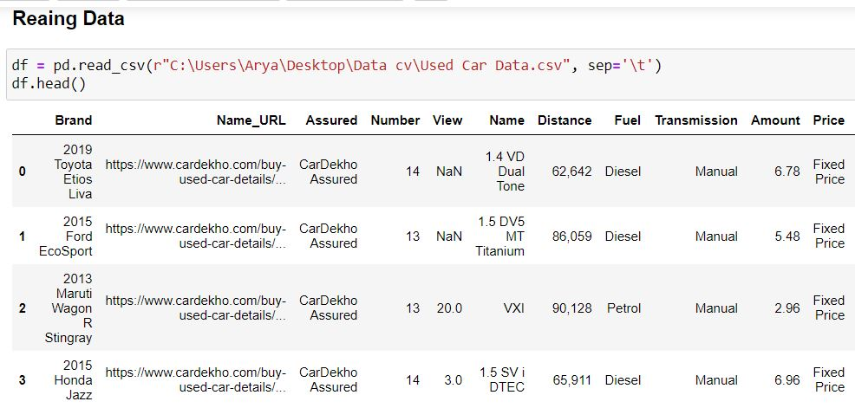
LOADING A DATA IN JUPYTER NOTEBOOK

Slide 5
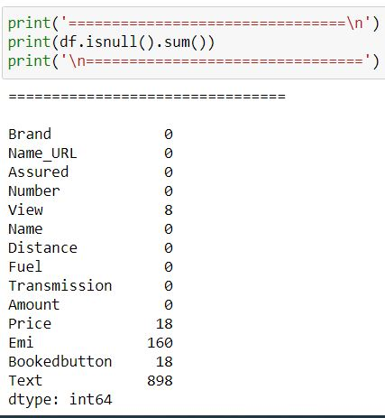
CHECKING NULL VALUE
There Is Null Value In Our Data Set.

Slide 6
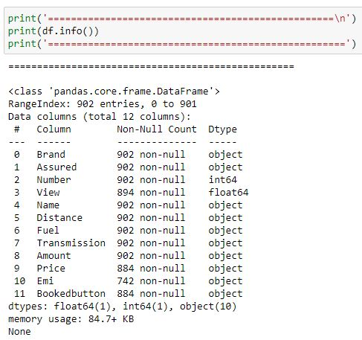
CHECK INFORMATION OF OUR DATASET
Categorical Value Found In Data Set.

Slide 7
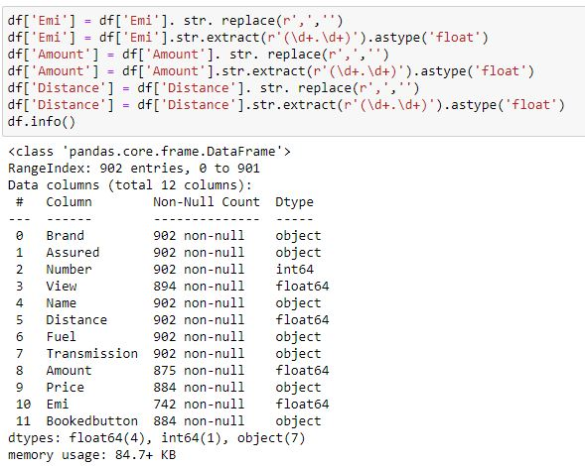
CONVERT OBJECT DATA INTO FLOAT
Features Are Converted

Slide 8
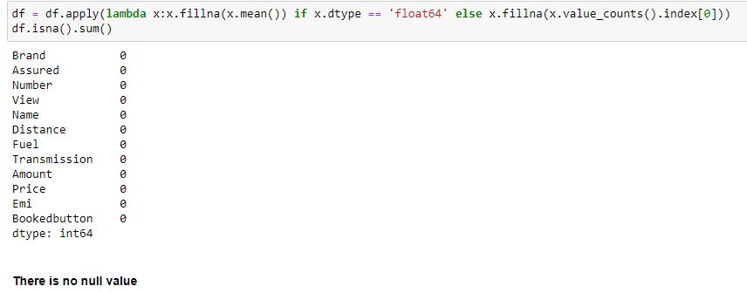
HANDLING MISSING VALUE WITH MEAN AND MODE

Slide 9
We do feature engineering adding manufacture year and brand.
We perform data analysis with plots.

Slide 10
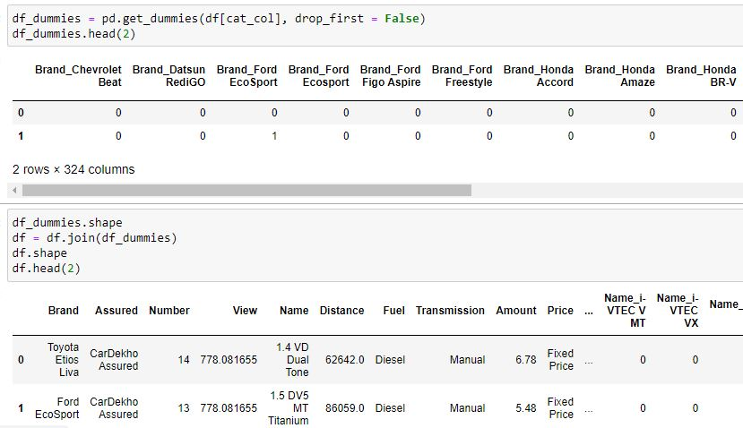
ENCODE CATEGORICAL DATA

Slide 11
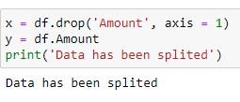
SPLITTING DATASET INTO FEATURES AND LABEL

Slide 12
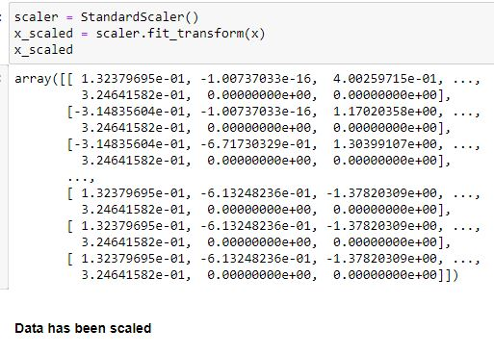
SCALE DOWN OUR DATA USING STANDARD SCALER

Slide 13
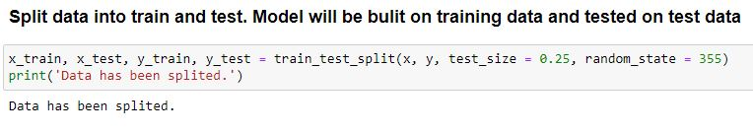
WE SPLIT DATA INTO TRAIN AND TEST

Slide 14
HERE I COMPLETED ANALYSIS

